Slide 1

Video Games Sales
Daniel Sterling
Aaron Suarez
Ivelisse Montero

Slide 2
Platform Sales
What Platforms had the highest sales?
What Platforms are most prominent in each major region?

Slide 3
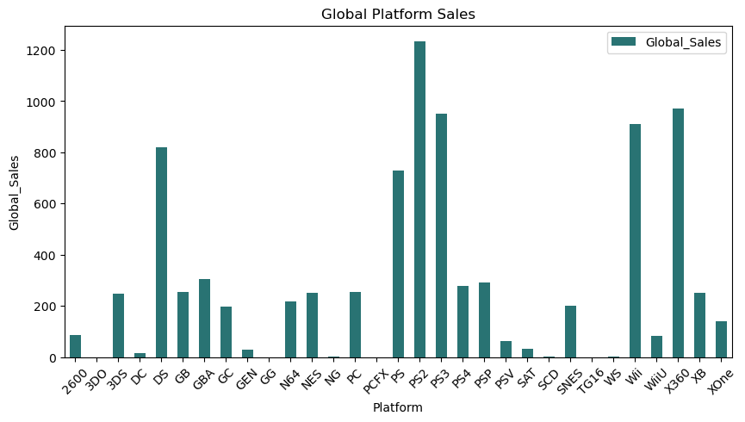
Global Platform Sales

Slide 4
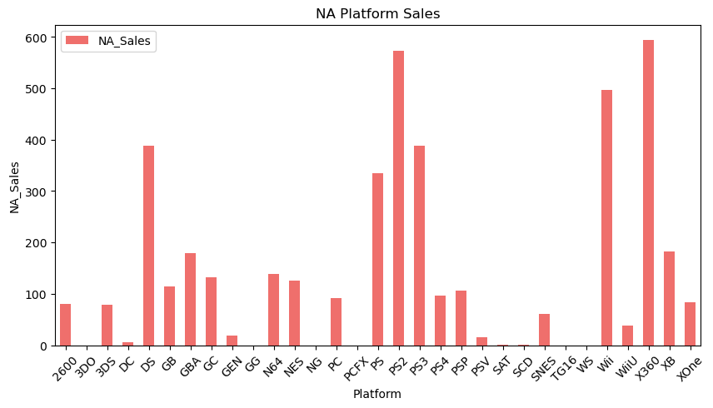
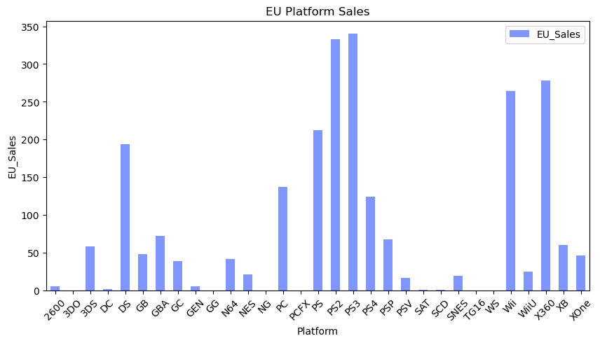
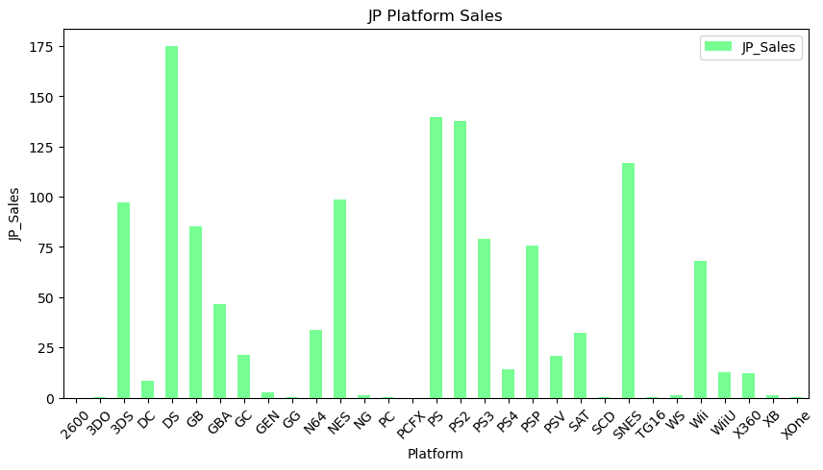
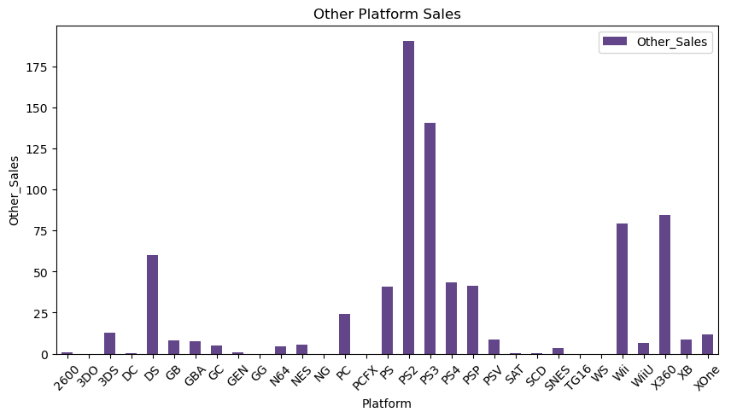
Platform Sales by Region

Slide 5
Genre Sales
What Genres had the highest sales?
What Genres are most prominent in each major region?

Slide 6
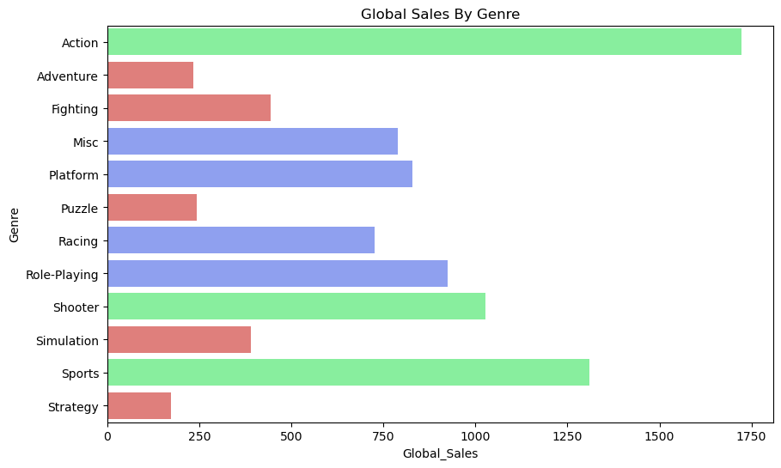
Global Genre Sales

Slide 7
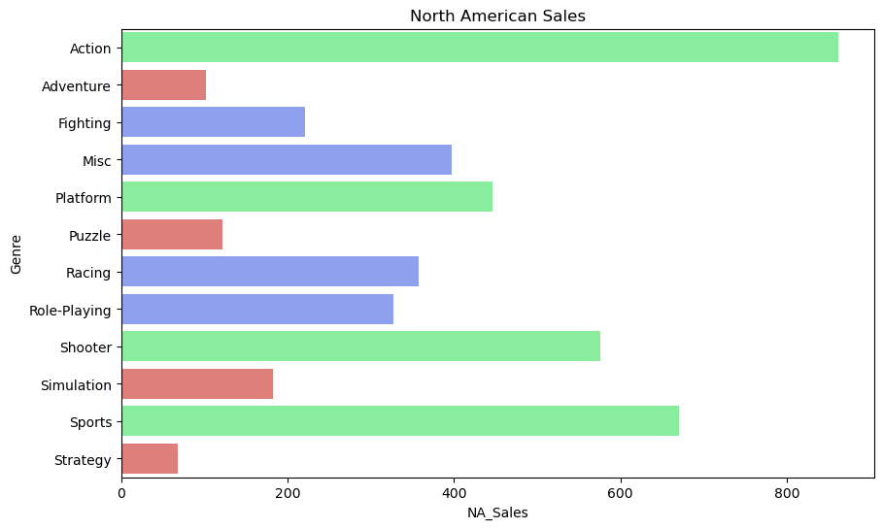
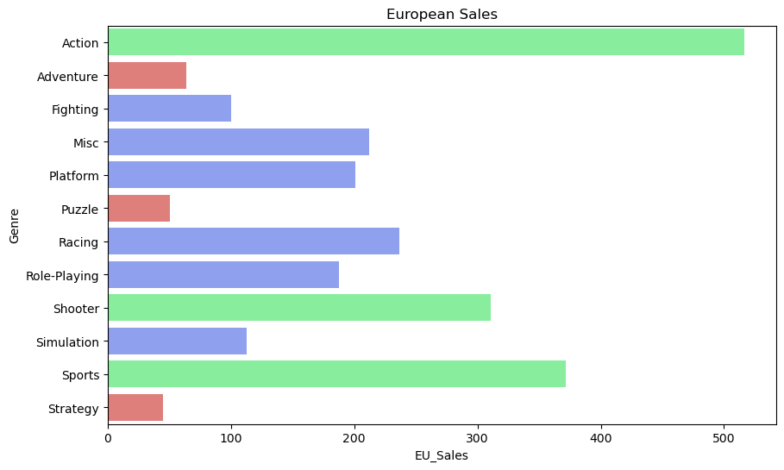
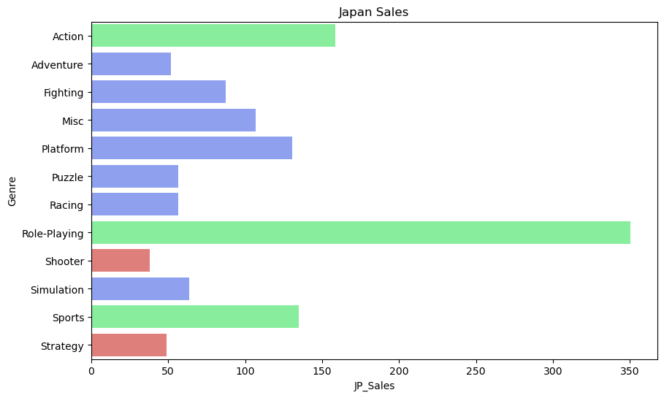
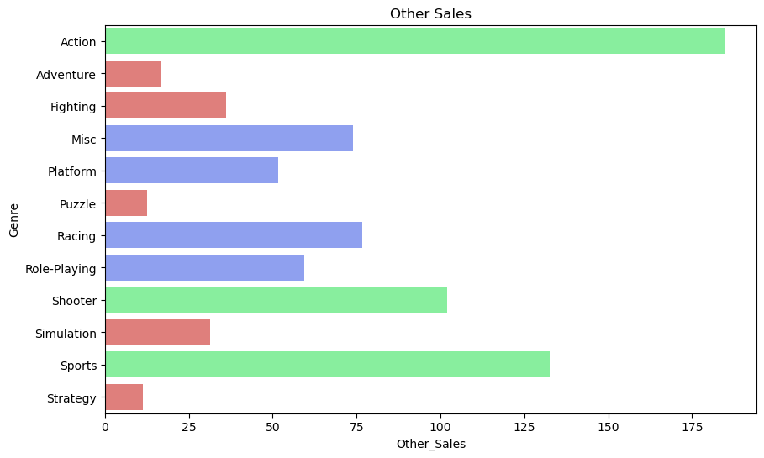
Genre Sales by Region

Slide 8
Major Contributions to Genre Sales
What were the three main genres seen in our data set?
What countries contributes most to these genres?

Slide 9
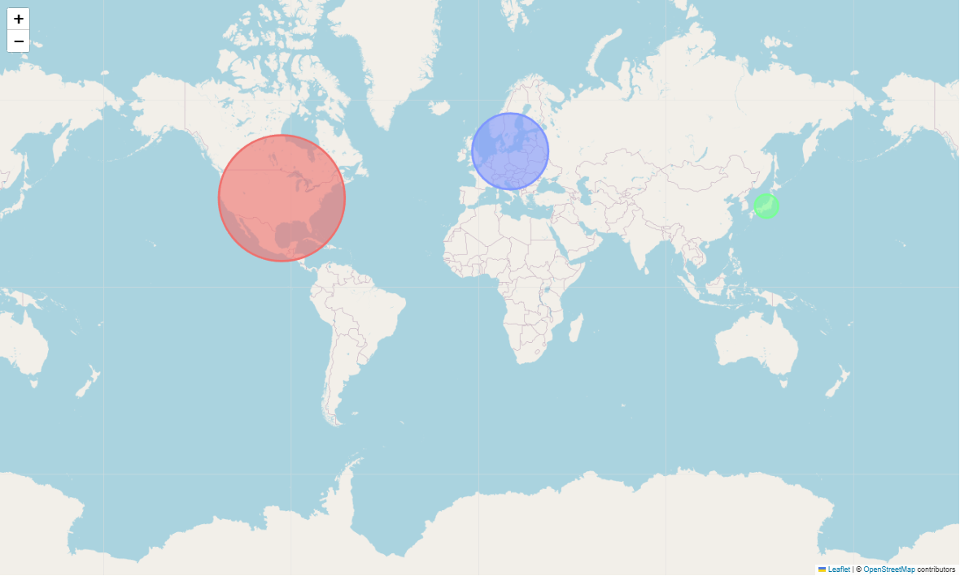
Action

Slide 10
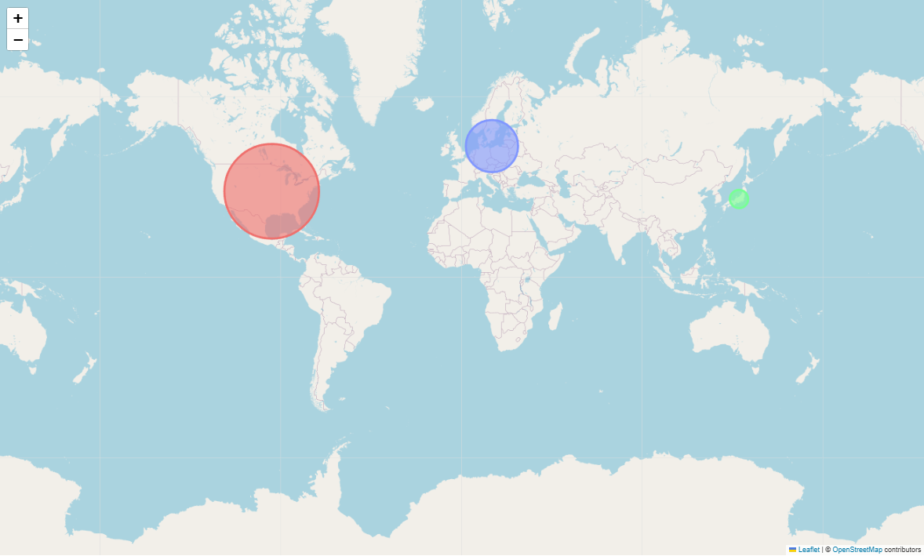
Sports

Slide 11
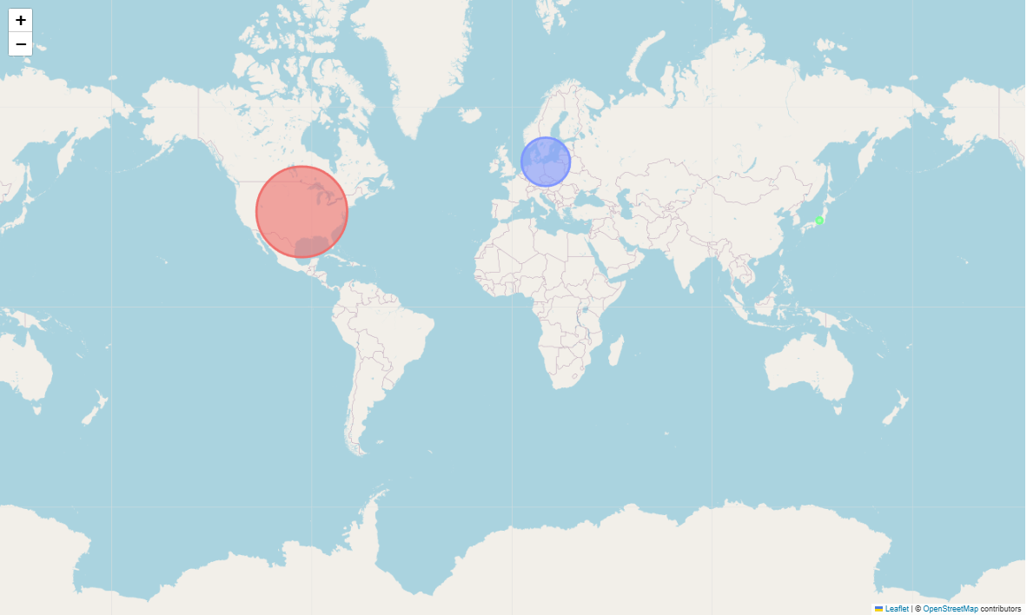
Shooter

Slide 12
Correlation Between Years and Sales
Does the year a game is release effect its sales?
What were the peak years for video game sales?

Slide 13
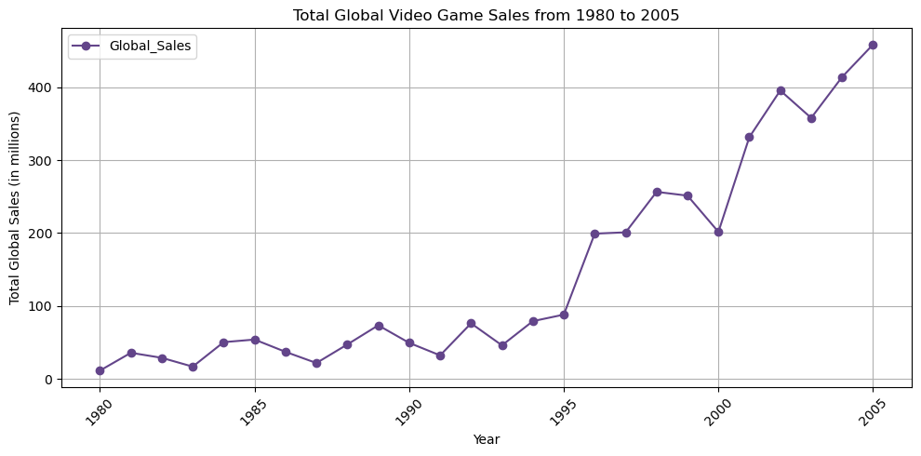
Global Platform Sales

